Slide 1
Ortho Eyes
Tony Andrioli
Business IT & Management Applied Mathematics
Kasper van der Hoofd - Carlijn Konings
Vincent van den Oord - Rogier Zitman
Luke de Keizer

Slide 2

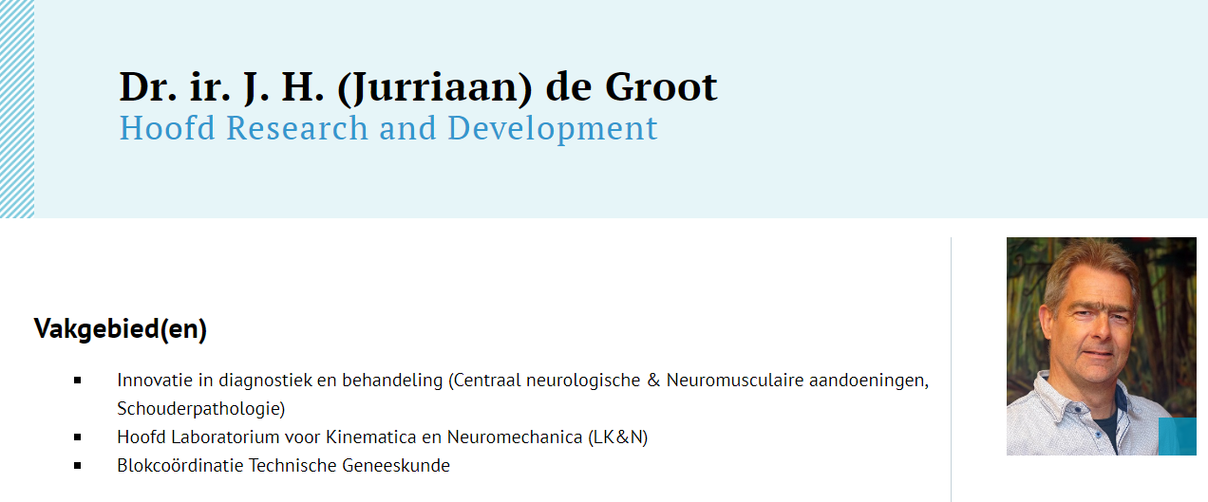
Our Client

Slide 3
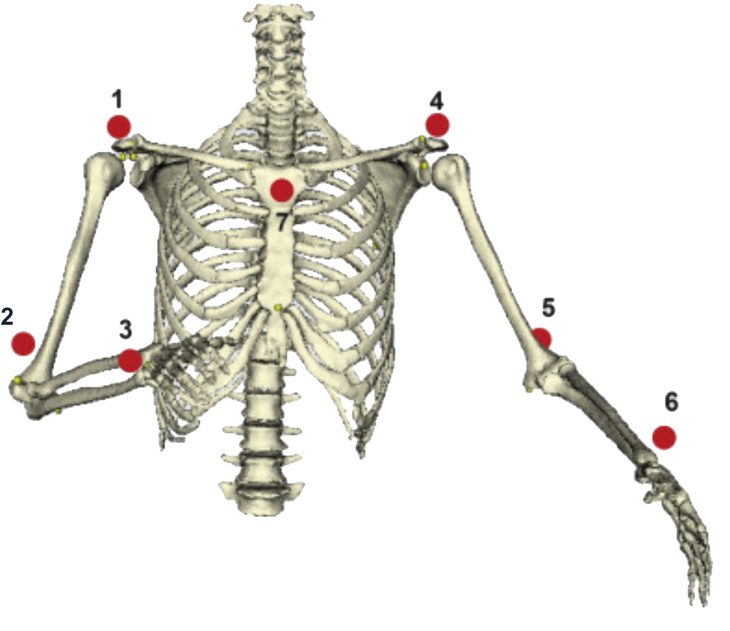
The data
The Leiden University Medical Center’s ‘Flock of Birds’- system
7 sensors
Every sensor measures:
Location in 3D
Rotation in 3D
Time series of these sensors are stored.
Sensor data is used to examine the (limitations of)
movements of bones from the shoulder joint.

Slide 4
The data
The data is handed over in 2 forms:
RAW sensor data
Cleaned sensor data: Location information is lost, rotation information is translated into angles of bones.
Research on the mobility of the shoulder joint has been done on several patient groups. The available data is an anonymized version of the recorded data.

Slide 5
The questions
Research has been done on different patient groups. But it is unknown to what extend the data can be used to distinguish these patient groups. Or as put by Kolk et al., (2017): “investigate whether kinematic analyses of shoulder motion are useful for diagnostic purposes.” In data science terms: make a classifier to differentiate the patient groups.
What parameters contribute the most to this classifier.
Can the value of these parameters be measured more easily in the future?
Is the assumption that the location data is irrelevant correct?

Slide 6
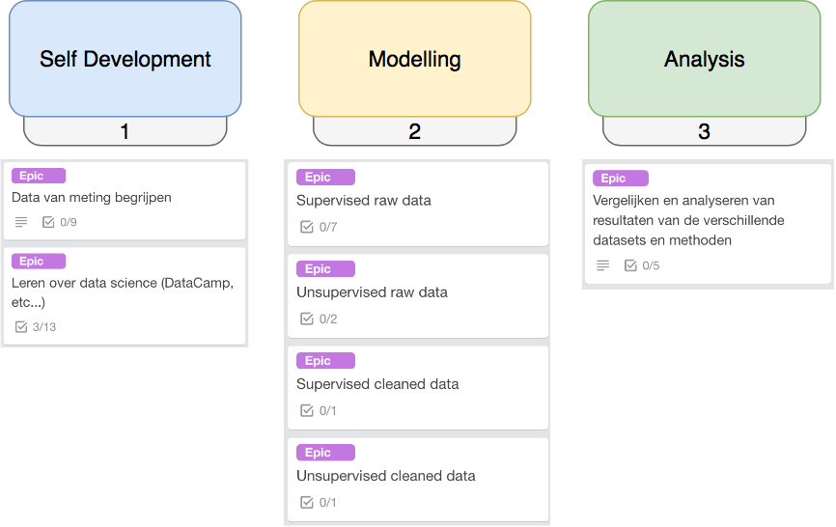
Approach:
Notes:
Modelling:
Supervised learning can result in the required classifier
Unsupervised learning is used to get more insight in the structure of the data and the medical relevance of this structure.
Analysis:
From the results form the model-stage, choose the best option, and analyse what parameters are important.

Slide 7
What have we achieved this sprint?
Practiced Python (with DataCamp)
Retrieved data
Gained insights into the data
Visualised the data
Understood the math behind:
Euler angle
Rotation matrices in ℝ^3

Slide 8
What have we planned?
A meeting with de Groot (LUMC)
Calculating with Euler angles
Continuing the DataCamp course
Receiving the remaining data
Trying to use machine learning / regression techniques on the LUMC data.
For example: Compare left and right shoulder Compare position of shoulder and rotation of shoulder blade

Slide 9
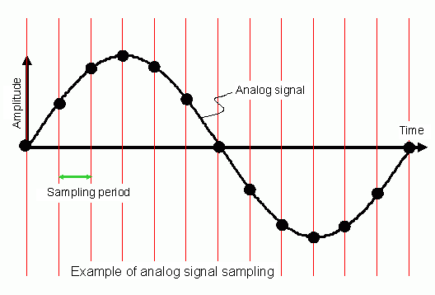
The problems we face or expect to face
Difficulty calculating Euler angles
Sample frequency is not constant
Difficulty using regression techniques for the analysis of time series
Notes:
Sample = niet consitent
Regressie = niet gemaakt voor tijdgevoelige informatie

Slide 10
Any questions or suggestions?

